Slide 1
Sunway IGSC
ANALYSIS OF
MALAYSIA'S HIGH-SKILLED TALENT SHORTAGE
UNDERSTANDING THE CHALLENGES AND SOLUTIONS

Slide 2

INTRODUCTION
Malaysia's labour market is experiencing a growing demand for high-skilled workers across various industries. However, this demand is met with a persistent shortage of qualified talent. This shortage not only impacts economic growth but also hinders the country's ability to compete in the global market. Understanding the root causes of this shortage is crucial for policymakers, businesses, and job seekers

Slide 3


Analysis
Findings
AGENDA
Recommendation

Slide 4



SECTION 1
ANALYSIS

Slide 5
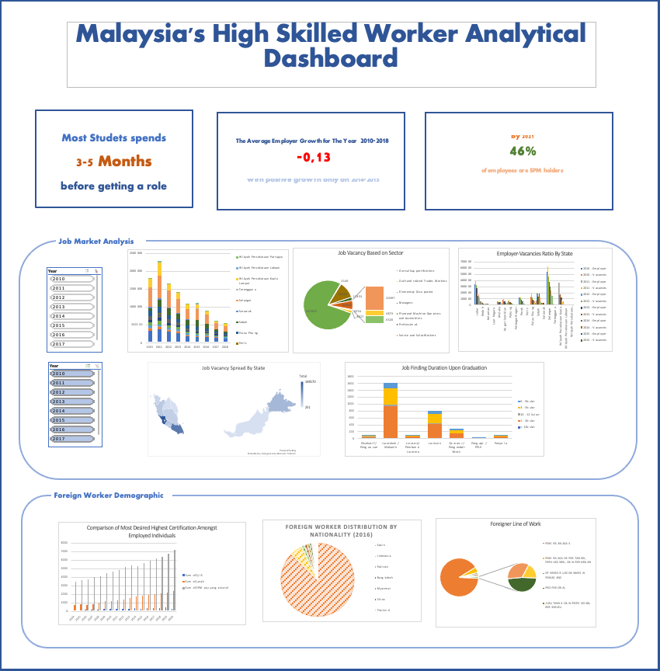

DASHBOARD
This dashboard covers report on Malaysia’s job market, as well as employee demographic. The employee demographic section covers the topic of foreign workers and educational background of Malaysia’s employees. This dashboard is aimed to investigate the reasoning behind shortage of high-skilled worker in Malaysia.

Slide 6
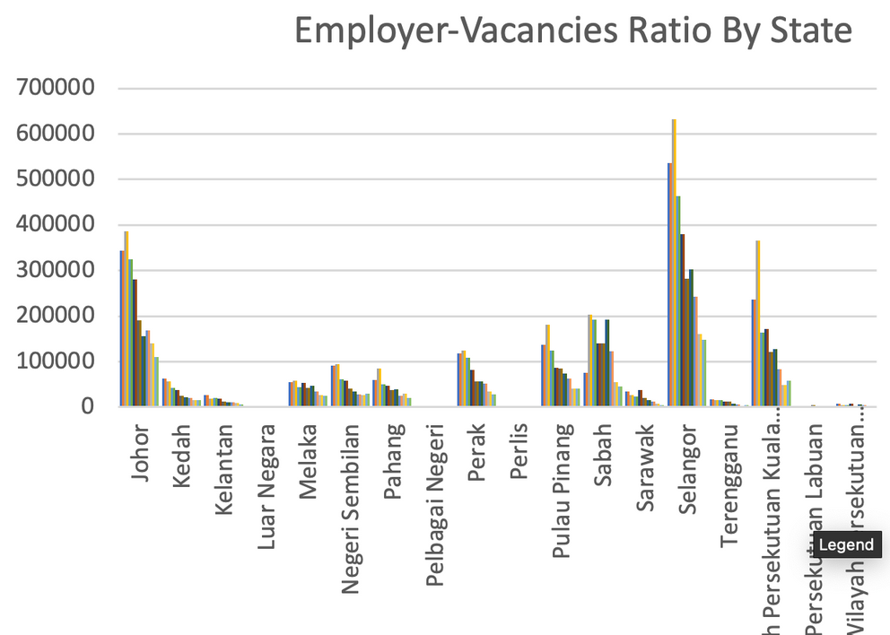
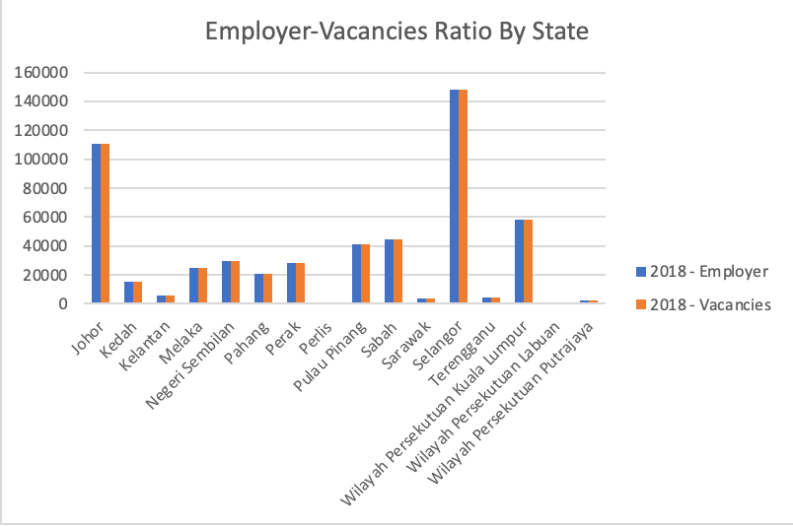
EMPLOYER-VACANCIES RATIO
From the data obtained, it can be seen that the employer and vacancies ratio is quite balanced. However, it can also be seen that the total amount of employee and vacancies has been declining significantly since 2011.

Slide 7
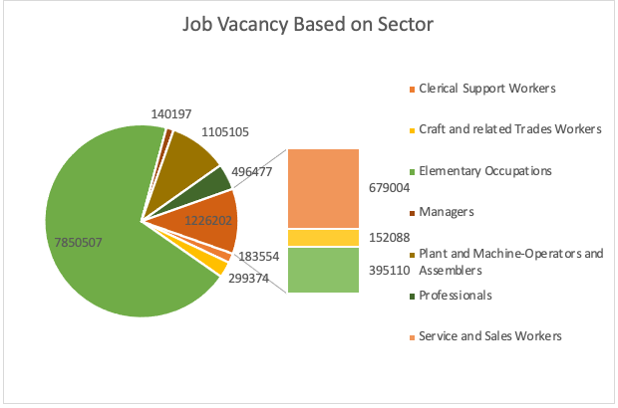
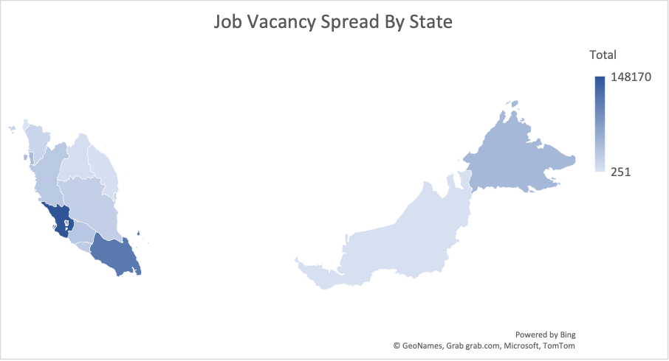
VACANCY ANALYSIS
The concentration of opportunities is not evenly spread with Selangor and Johor as the leading state, while the other state has quite a high contrast compared to the two states. Sector wise, by 2018, and consistently throughout the year, professionals and managers are the most in demand sector.

Slide 8
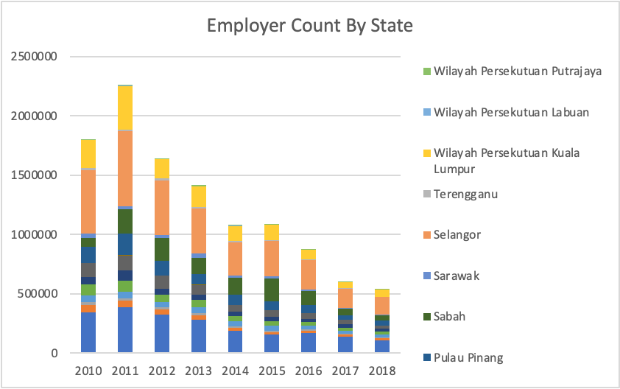
MALAYSIA’S BUSINESS GROWTH
From the analysis, a noteworthy trend emerged, revealing a substantial decline in the number of employers. This data indicates that business growth in Malaysia has not been as robust as expected or required to support the demand for high-skilled talent. The chart further illustrates the disparity of employer across states.

Slide 9
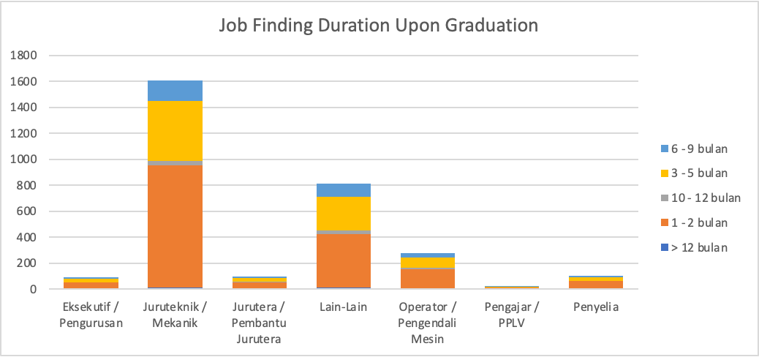
MALAYSIA’S BUSINESS GROWTH
We discovered that mechanics and technicians encounter the most difficulty in securing employment, as evidenced by the prolonged duration it takes for them to secure a job following graduation

Slide 10
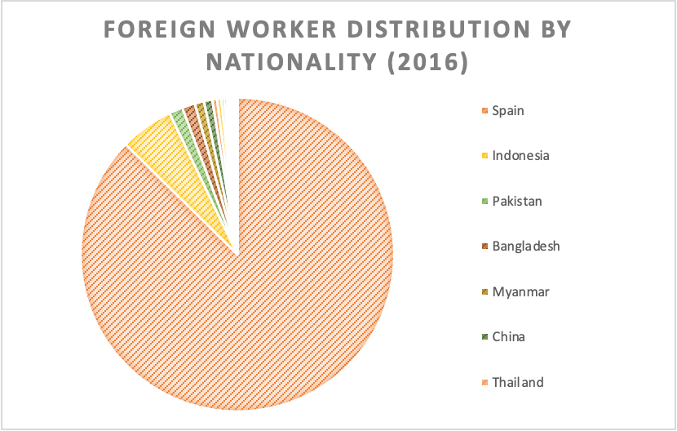
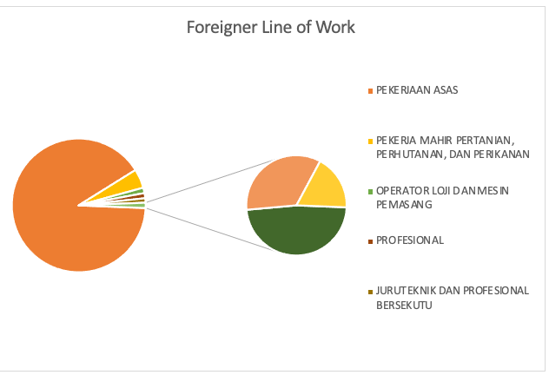
FOREIGN WORKER DISTRIBUTION
It was observed that among expatriates, Spain boasts the highest number of foreign workers, with Indonesia closely following. However, a striking revelation from our analysis is that a staggering 91 percent of foreign workers in Malaysia are employed in low-level positions.With only 5% employed as technician and associate, and managers.

Slide 11
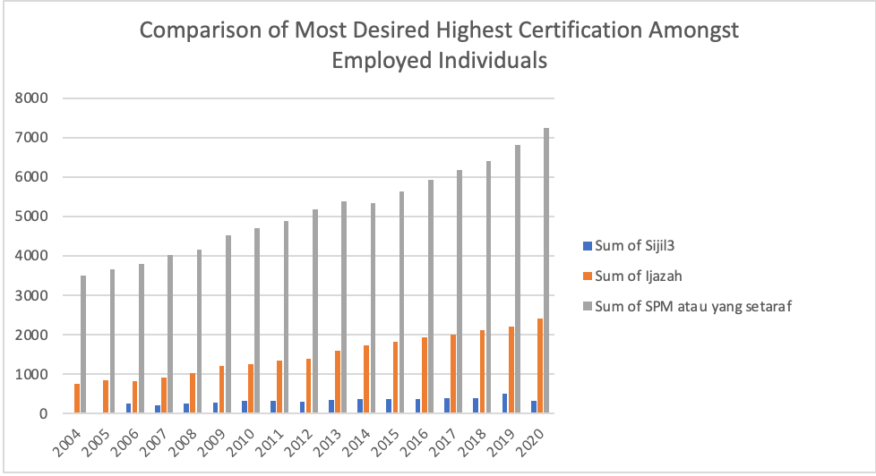
EMPLOYEE’S HIGHEST DIPLOMA
While the overall employment growth remained steady, our analysis revealed a concerning trend. By the year 2018, a noteworthy 46% of employees in the workforce were found to possess no higher than an SPM qualification, signaling potential challenges in meeting the increasing demand for high-skilled talent

Slide 12


SECTION 2
FINDINGS AND COMPARATIVE ANALYSIS
In this section we willgo over the findings obtained from the analysis, as well as a comparative analysis between Malaysia and New Zealand.

Slide 13










COMPARATIVE ANALYSIS
Malaysia vs New Zealand
COUNTRY
GEOGRAPHICAL DISPARITY
SECTORAL DISPARITY
EDUCATIONAL
EMPLOYER GROWTH
VISA OPTION
Malaysia
IMBALANCED
LOW-LEVEL JOB IS MORE ON DEMAND
SPM QUALIFICATION IS HEAVILY ON DEMAND
LOWER BUSINESS GROWTH
2 OPTIONS
New Zealand
JOB IS SPREAD EVENLY THROUGHOUTS SECTORS
DEGREE IS MORE ON DEMAND
BALANCED
CONSTAND ECONOMIC GROWTH
5 OPTIONS
Notes:
In Malaysia, there is often a significant geographic disparity in job opportunities. The capital city, Kuala Lumpur, tends to have a higher concentration of job openings, particularly high-skilled positions, while other regions may have fewer opportunities. This imbalance can make it challenging for individuals in less urban areas to access high-skilled jobs.
New Zealand, on the other hand, appears to have a more even distribution of job opportunities across regions. The country's smaller population and diverse economy contribute to this balance.

Slide 14
Summary
Malaysia exhibits disparities in job opportunities with geographic imbalances, a variation in sectoral demand, educational disparities, and a concentration of high-skilled jobs in the city compared to urban area. The composition of foreign workers, including those in low-level positions, further influences job distribution.
New Zealand, with a smaller population and diversified economy, presents a more balanced distribution of job opportunities across regions and sectors, reducing disparities. It maintains a focus on attracting highly skilled immigrants.
New Zealand offers a range of visa options tailored to specific categories of workers and individuals, including skilled migrants, students, and entrepreneurs.
Malaysia primarily provides work visas to foreign employees, which are often tied to employment with local companies.
New Zealand places a strong emphasis on attracting highly skilled and educated immigrants, with various pathways for skilled workers.
Malaysia focuses on employment-related visas, making it more accessible for those with job offers but potentially limiting opportunities for other types of immigrants.

Slide 15

SECTION 3
RECOMMENDATION

Slide 16
Strategic Plan
Objectives | Streamline Immigration Procedure | Enhance Visa Options | Education and Training | Targeted Indsutry Support
Action Steps | Revise and simplify visa and work permit application processes. Implement an online application system. | Create a High-Skilled Professional Visa category. Offer pathways to permanent residency for eligible high-skilled workers. | Collaborate with educational institutions to update curricula to meet industry needs. Launch scholarship programs for local students pursuing high-skilled professions. Create a national upskilling program. | Identify industries with high demand for high-skilled labor. Provide incentives, grants, or tax breaks to businesses in these sectors.
Key Performance Indicator | Reduction in visa processing time. Increase in the number of high-skilled workers successfully obtaining work permits. | The number of visas issued under the new category. The percentage of visa holders who pursue permanent residency. | Increase in the alignment of educational programs with industry demand. The number of students benefiting from scholarships. | Increase in job openings in targeted industries. Growth in the number of businesses in supported sectors.

Slide 17
Sources
Visas that allow you to work (no date) Immigration New Zealand. Available at: https://www.immigration.govt.nz/new-zealand-visas/visa-lists/all-work-visas (Accessed: November 2023).
Visas that allow you to work (no date) Immigration New Zealand. Available at: https://www.immigration.govt.nz/new-zealand-visas/visa-lists/all-work-visas (Accessed: November 2023).
Work in Malaysia - types of Malaysia work visas and permits (no date) VisaGuide.World. Available at: https://visaguide.world/asia/malaysia-visa/work/.
Work in Malaysia - types of Malaysia work visas and permits (no date) VisaGuide.World. Available at: https://visaguide.world/asia/malaysia-visa/work/.
Employment rate in New Zealand by highest qualification and sex (no date) Figure.NZ. Available at: https://figure.nz/chart/A61a66HPJvJiwbbS-048RQsh0rd7SwEzx.
data source: https://data.gov.my

